Slide 1
Pokemon Bullet Hell
By Samantha Wolf, Damien Hutton, Dexter Siberell, & Marcus Holm

Slide 2
Origin of the Game
Group brainstorming session
Picked our top ideas and combined them
Reasoning-combined things we were all interested in and sounded fun :)

Slide 3
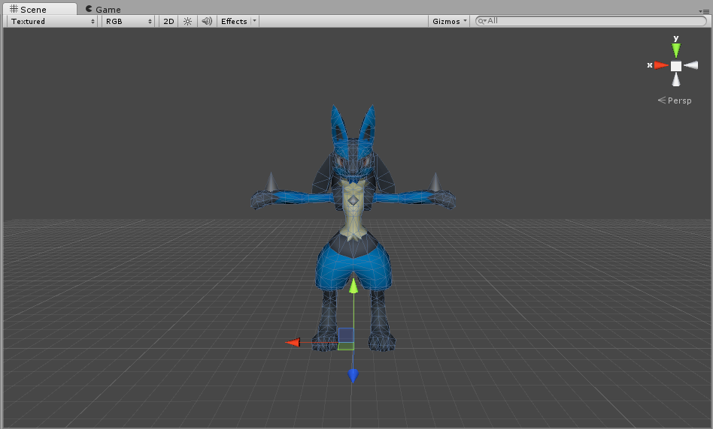
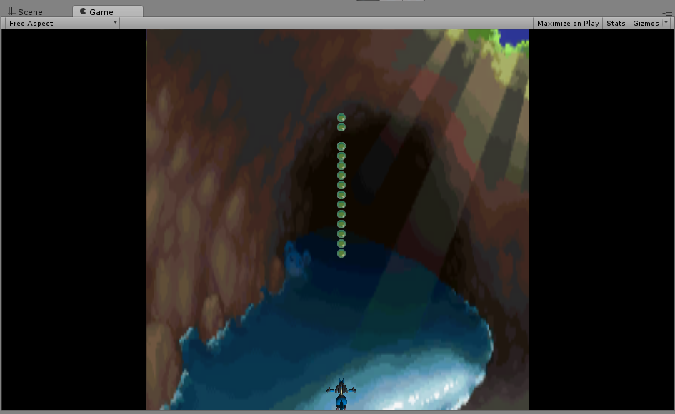
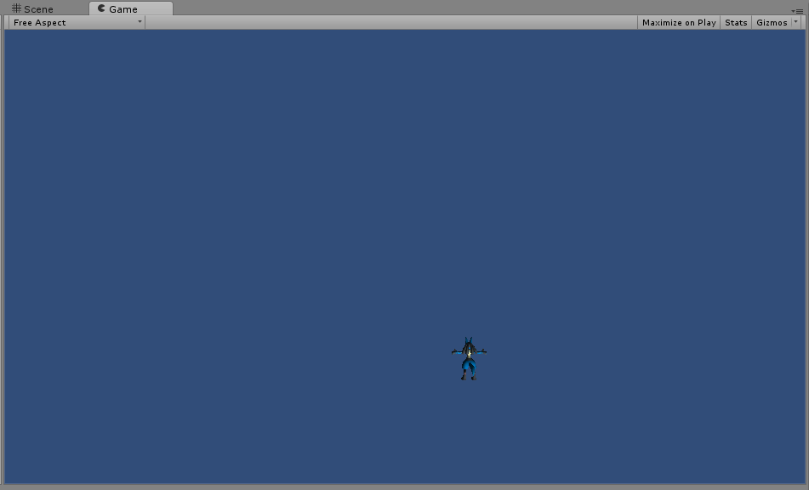
Early Progress Shots
Lucario put on his side, camera locked into position, and now Lucario moving around!
Lucario model imported into the scene, worked with it.
Controls with firing bullets, background, and framing squares. A solid barebones prototype!

Slide 4
Playtest 1-Suggestions
Add restart and lives
Fix the sound
Difficult at first-ease in
Add animation when the player is hit
More pokemon, bullets in different patterns
Add score

Slide 5
Playtest 2-Suggestions
Damage to enemies-make more obvious
New playable characters and enemies
Powerups
Health bar for boss
Fixing bullets
Add a story :D
Changing the background for bosses

Slide 6
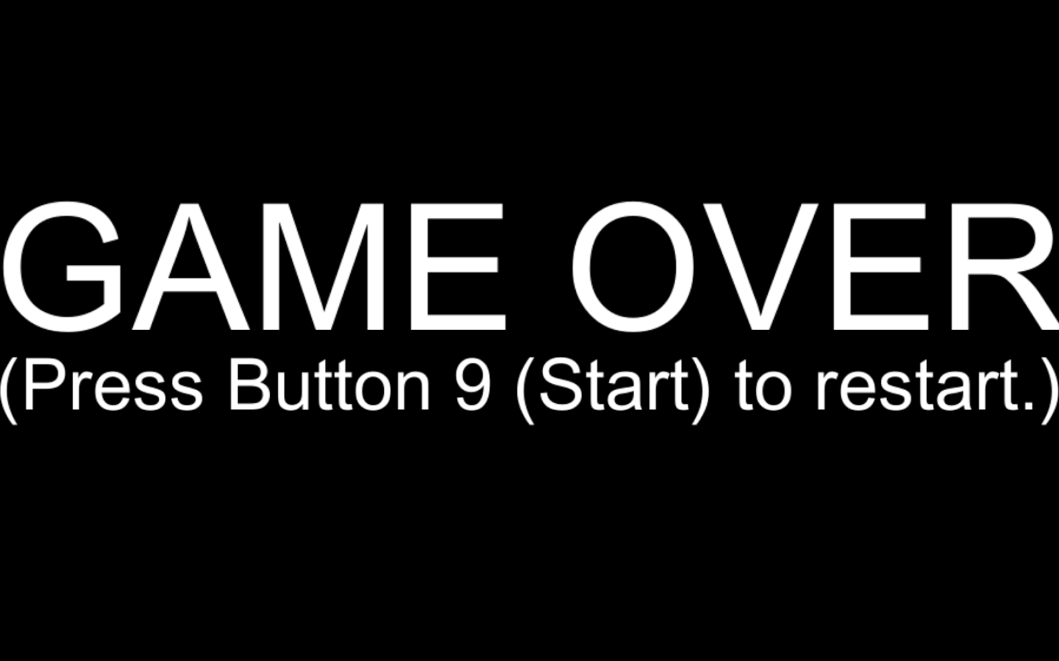
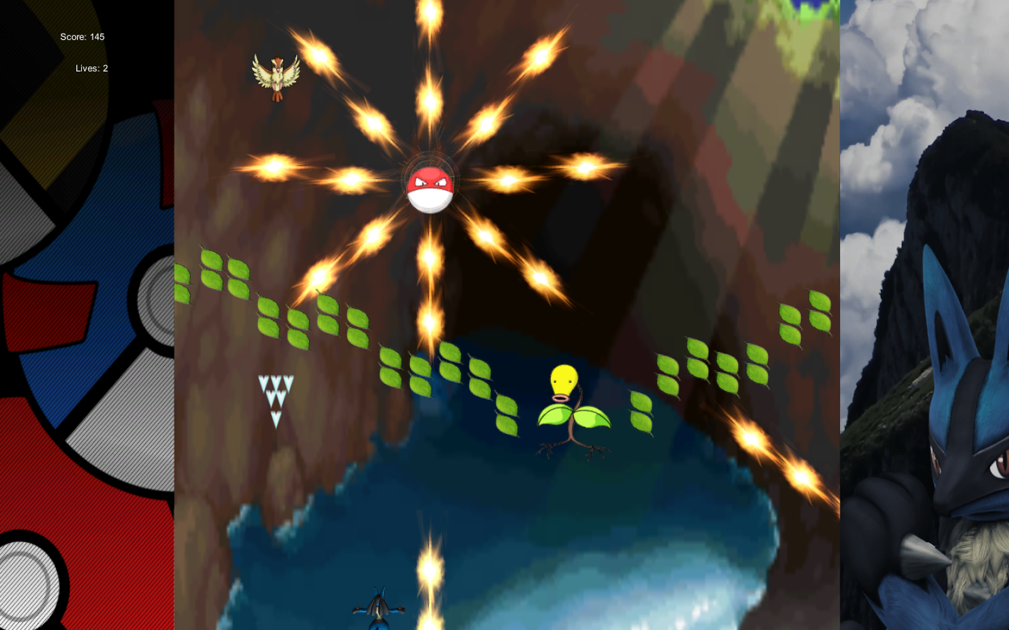
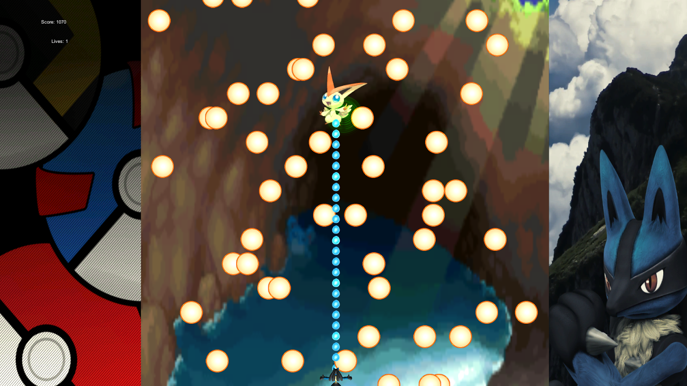
Recent Progress Shots
Implemented boss (Victini), with lots of on-screen bullets and score!
Lots of enemies now, with Bellsprout as well as Pidgey.
Implemented Game Over screen.

Slide 7
Future of the Project
We’re all going to work on it together as a family (ohana means family, and family means NO ONE LEAVES)
Slow down and show hit box
Bomb that clears the screen
More levels/bosses
Pause button with restart option

Slide 8
Conclusion of the Project
Original scope/features-Check
Major problems-Boss, Bellsprout bug, Vine Whip, Lucario uses Teleport sometimes, Animation Implementation
If we had a redo:
Lucario’s bullets
Built with a pause in mind

